Slide 1
Where are we now?
Period of profound change – economic, social, cultural
We have to ask not only WHAT people read but HOW they read
Particularly important for young people

Slide 2
The equality question
Q: Can digital product development close gaps in opportunity between students from schools in poorer and more affluent areas?
A: I certainly think that there's potential here, but there are also risks. We need to ensure the less well-off have equal access to resources or we’ll be widening the divide instead of closing it

Slide 3
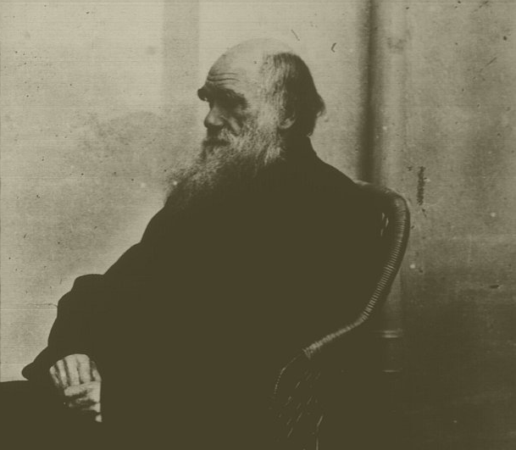
Good news – access to archives

Slide 4
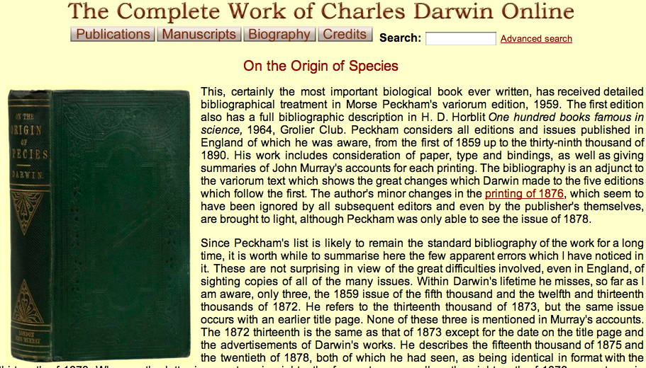
Cambridge University archive

Slide 5

It’s there, but will anyone read it?
Use of internet does not necessarily mean that people only read short texts

Slide 6
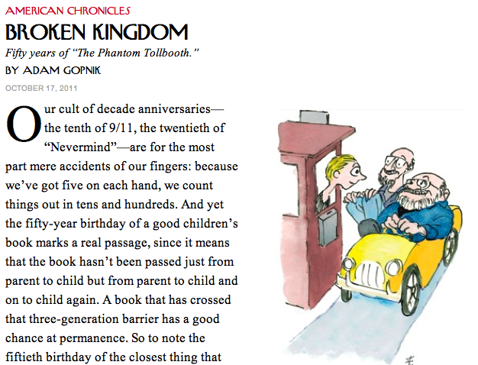
Abracadabra!

Slide 7
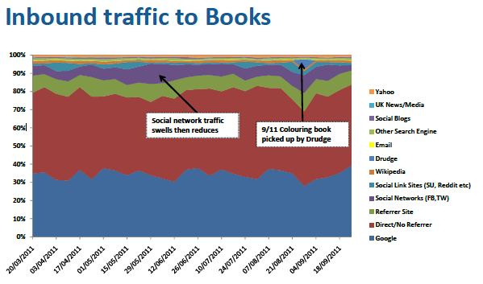
New ways to spread the word

Slide 8
Challenges of change
How to make money
How to store information
Which technologies to choose
Loss of authority

Slide 9
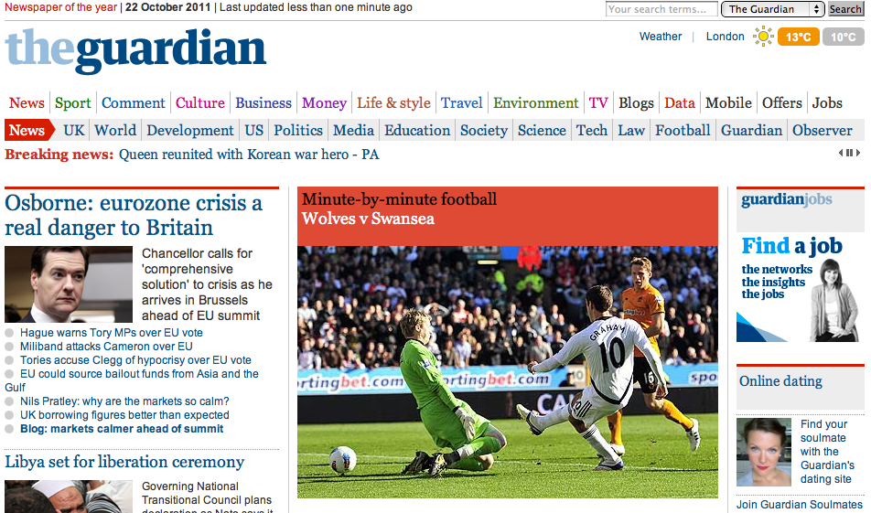
Journalism for free

Slide 10
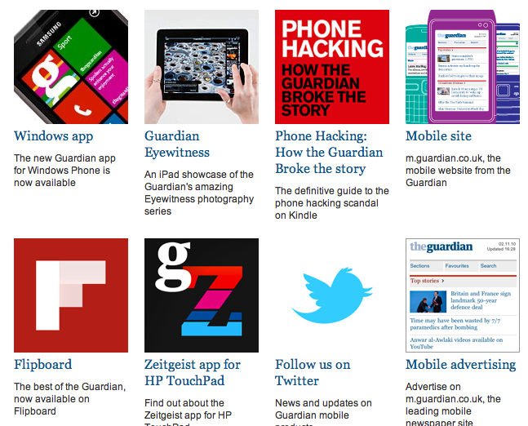
Not just a newspaper

Slide 11
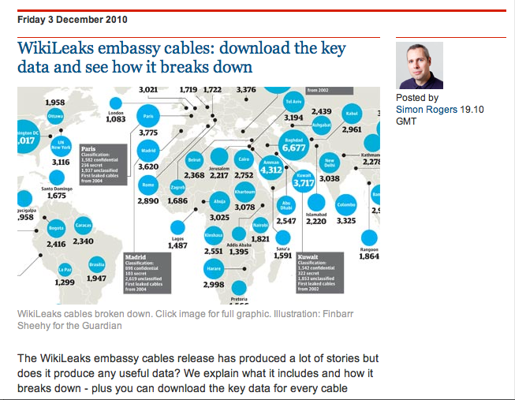
Data journalism

Slide 12
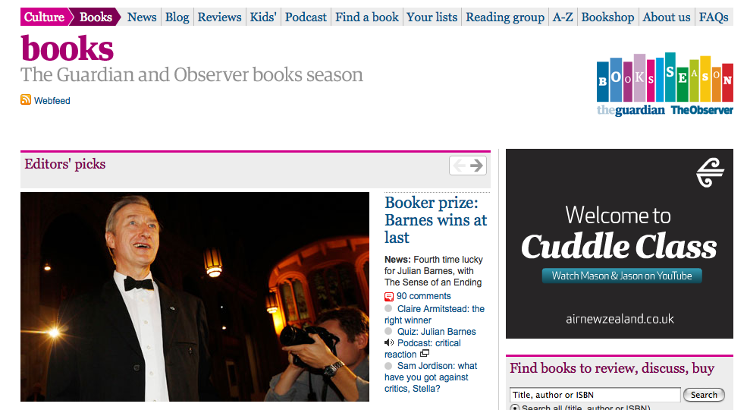
guardian.co.uk/books

Slide 13
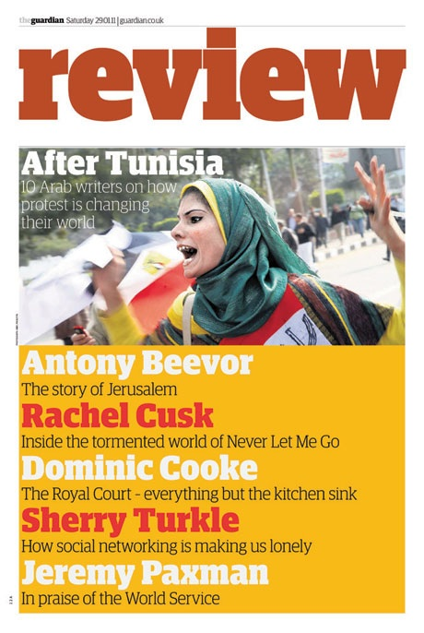

Slide 14
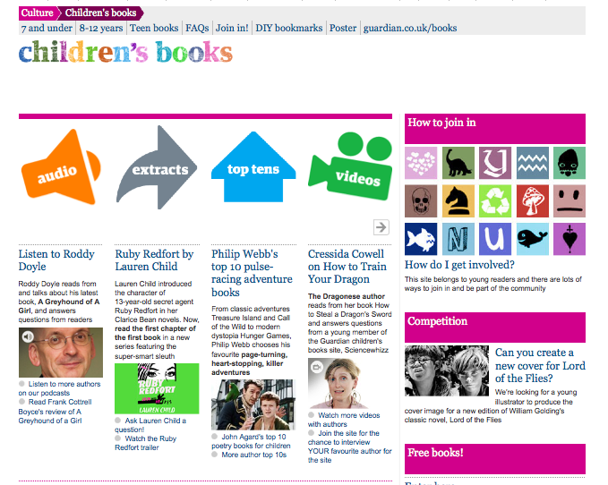

Slide 15

New partnerships

Slide 16
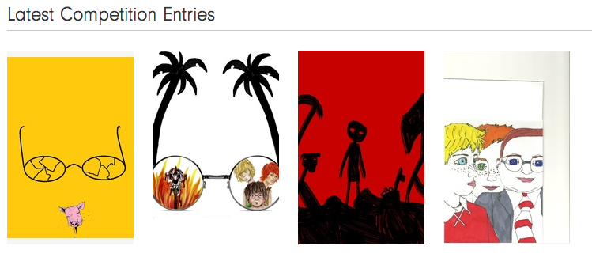
From the Faber website

Slide 17
Interactive storytelling

Slide 18
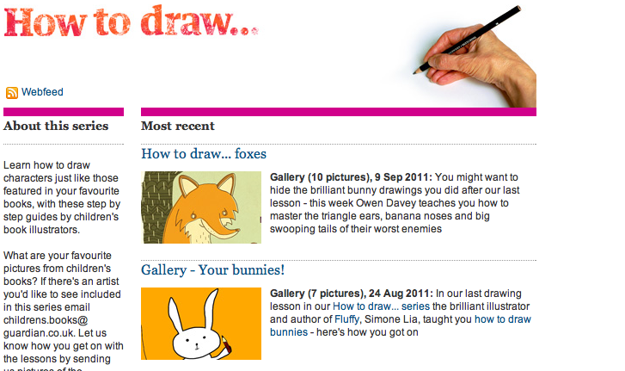
New ways of telling stories

Slide 19
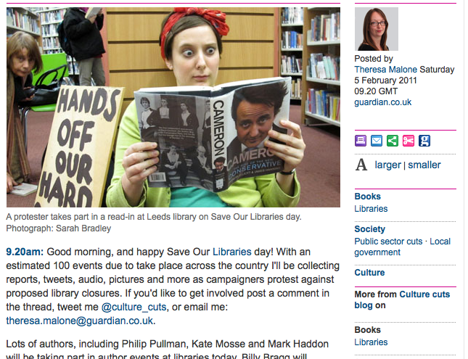
Campaigning blogs

Slide 20

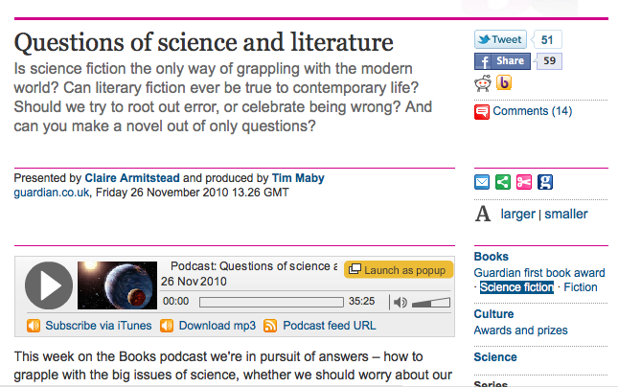
Podcasts

Slide 21
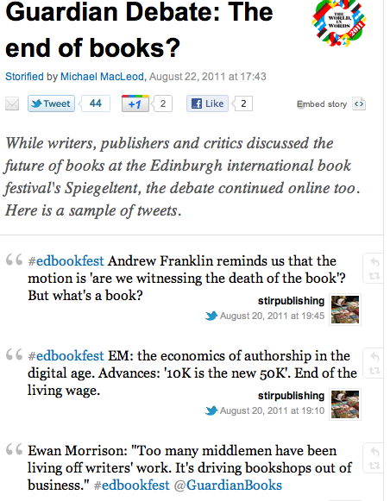

Slide 22
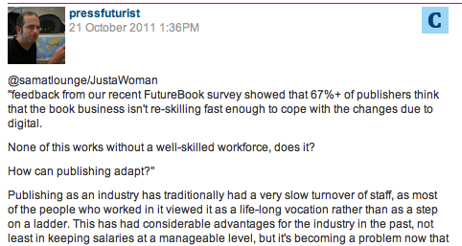
The importance of change

Slide 23
The new universe: Touch books

Slide 24
Learning opportunites

Slide 25

The End

